Slide 1


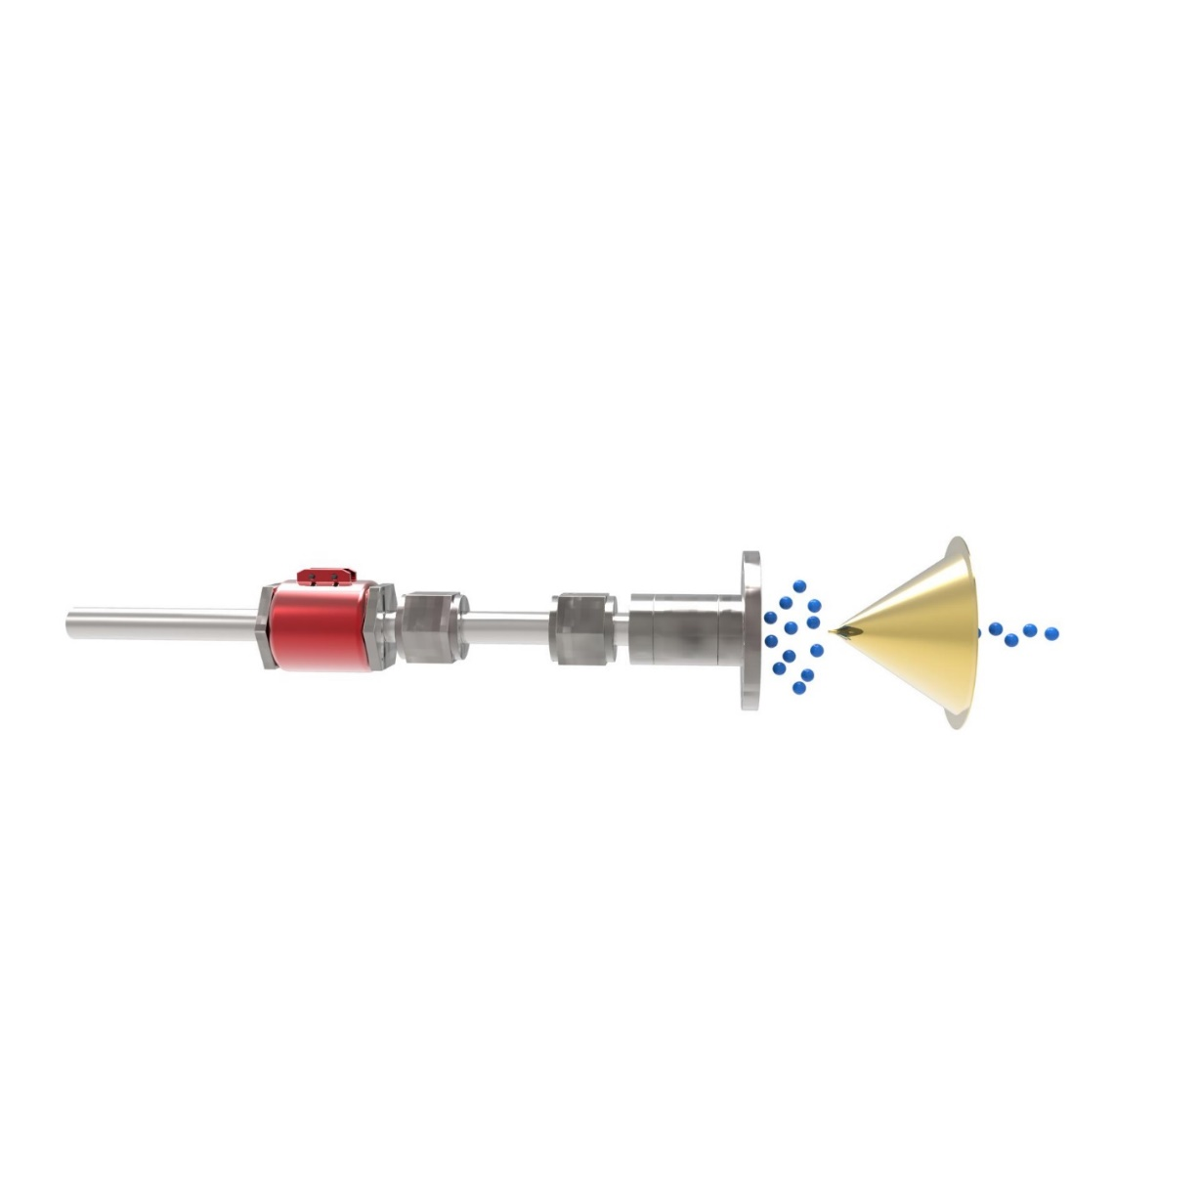
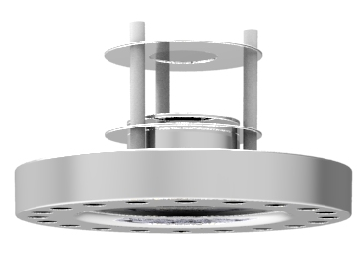
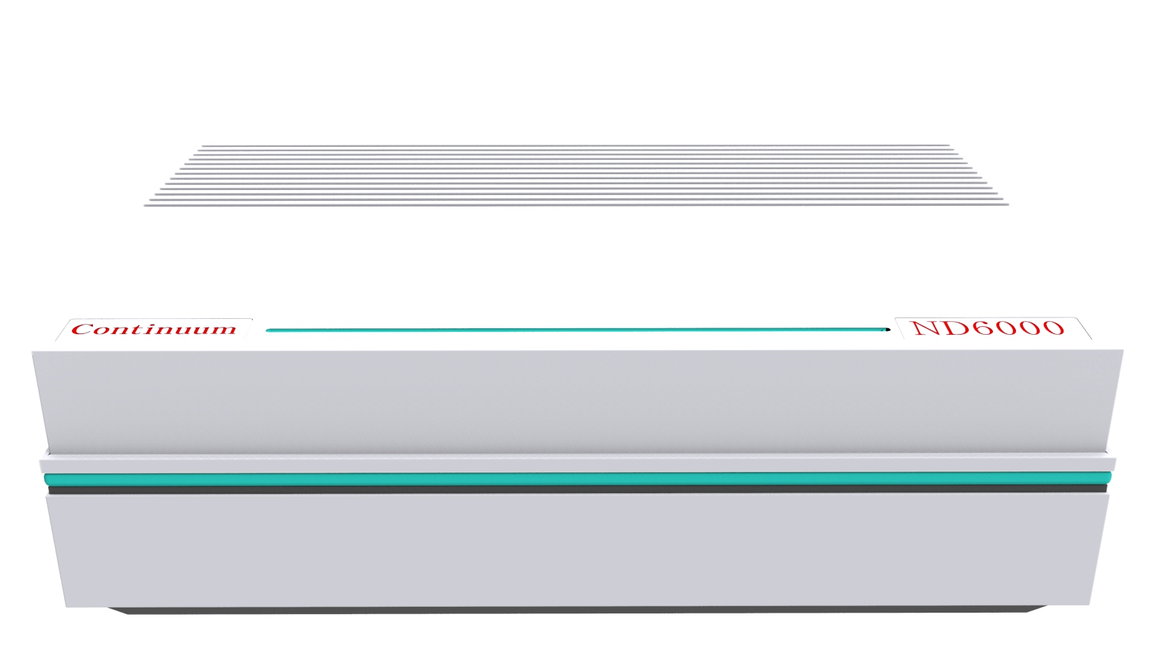
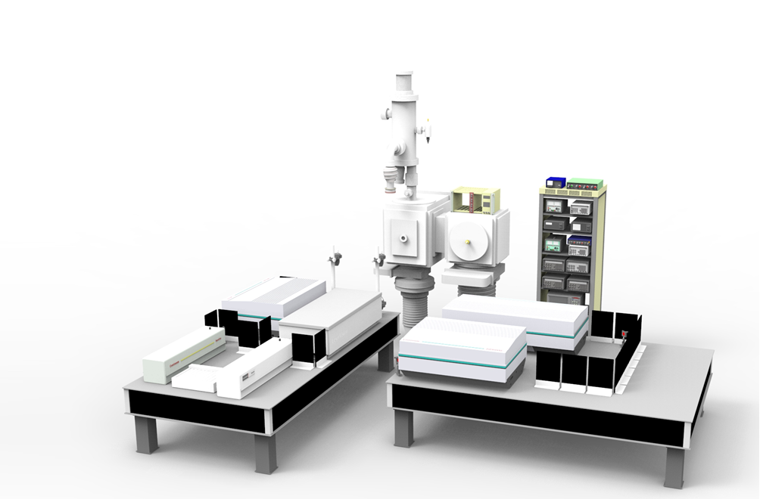

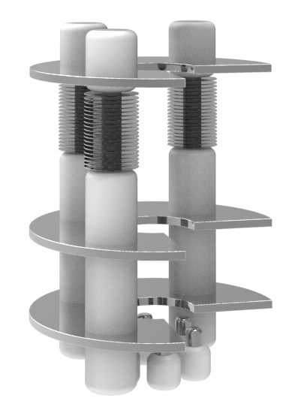
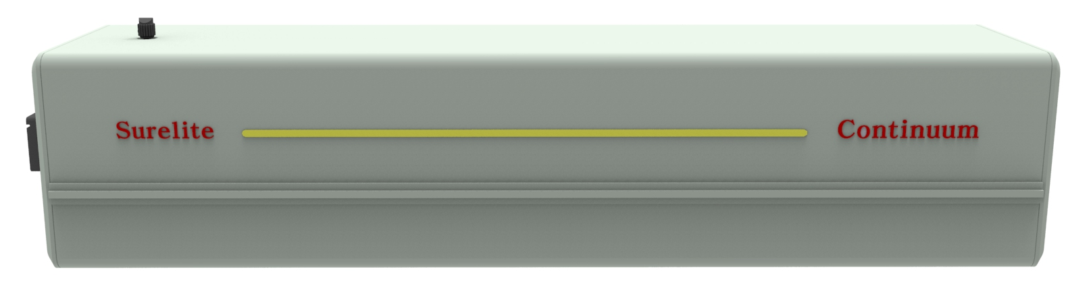
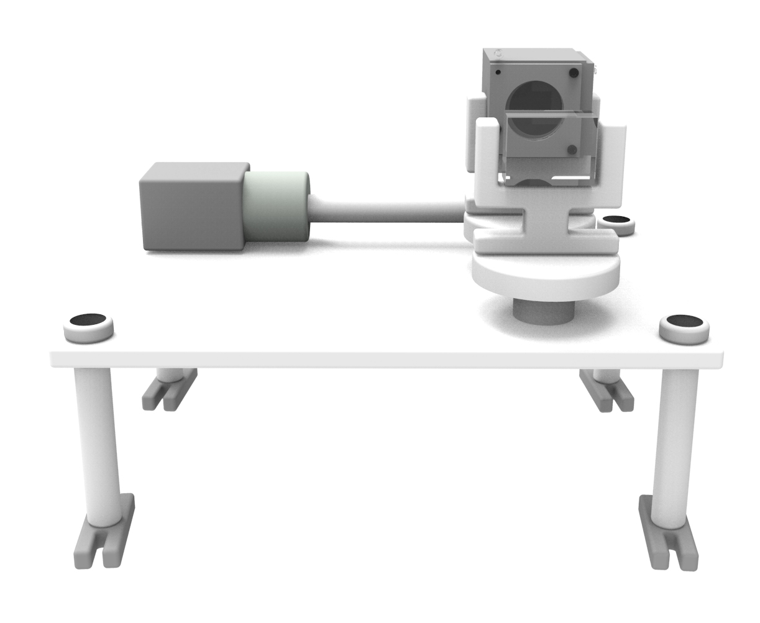
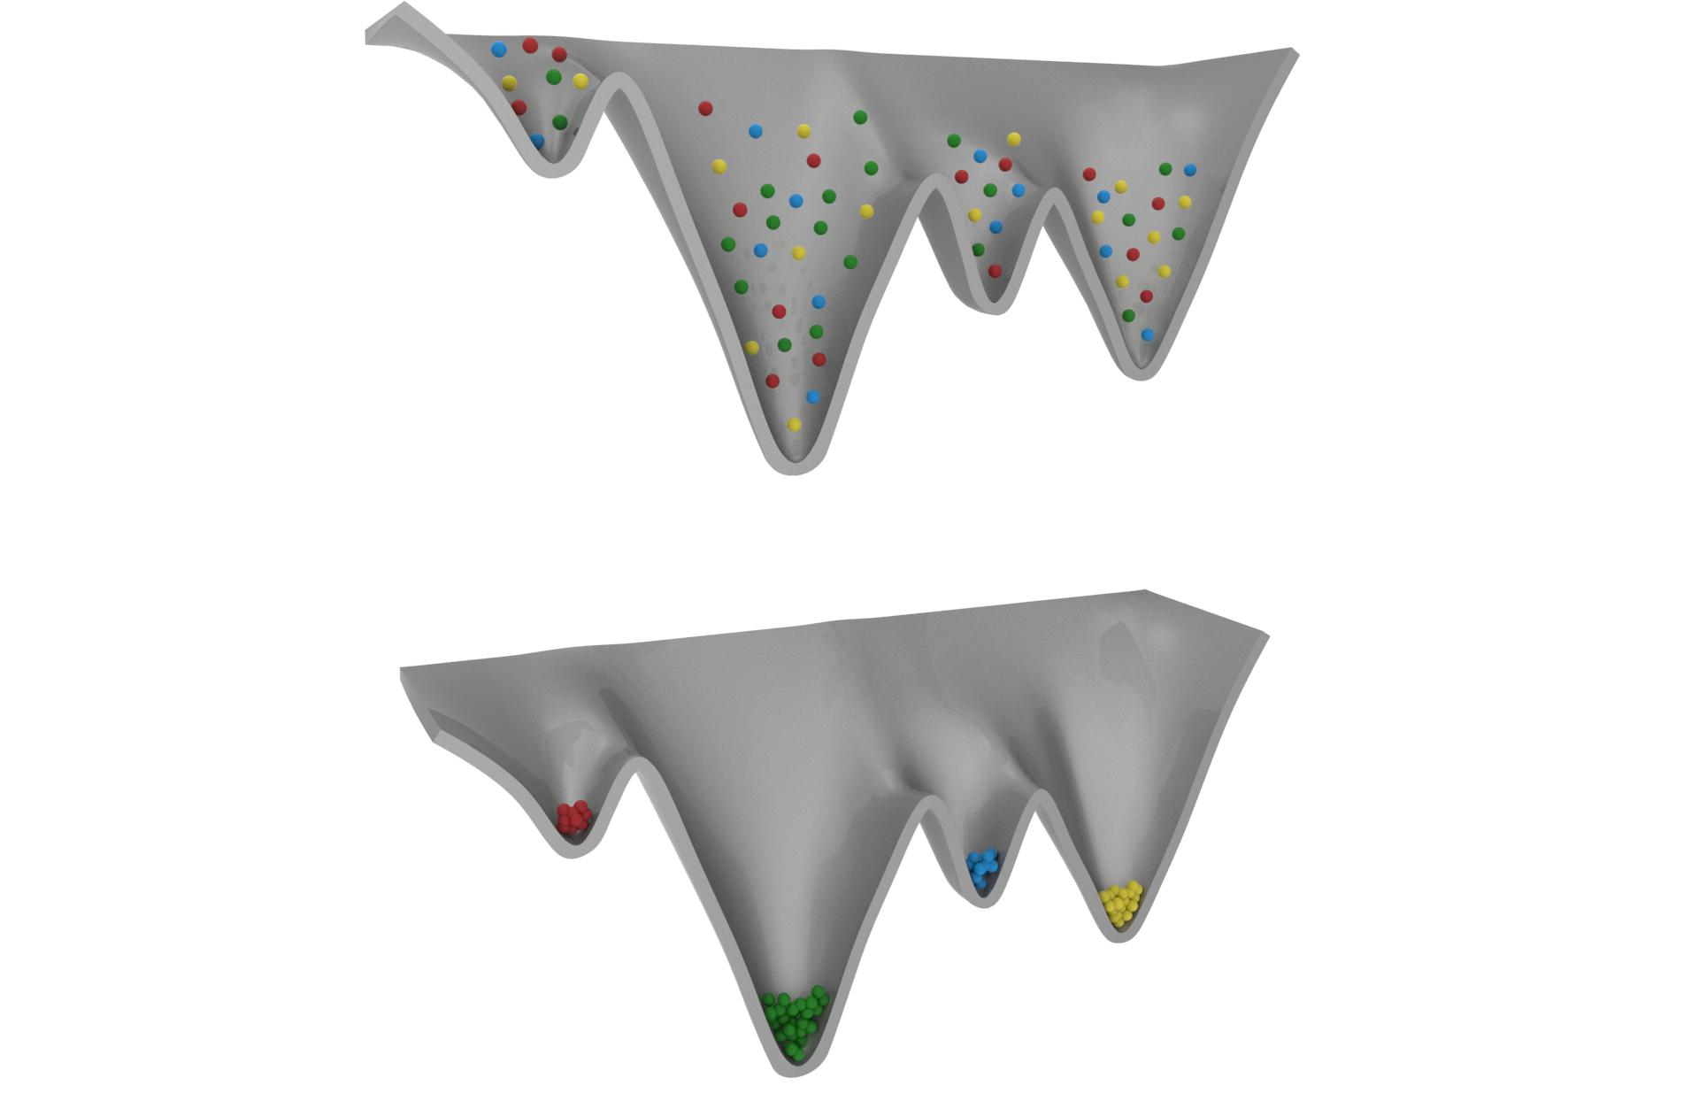
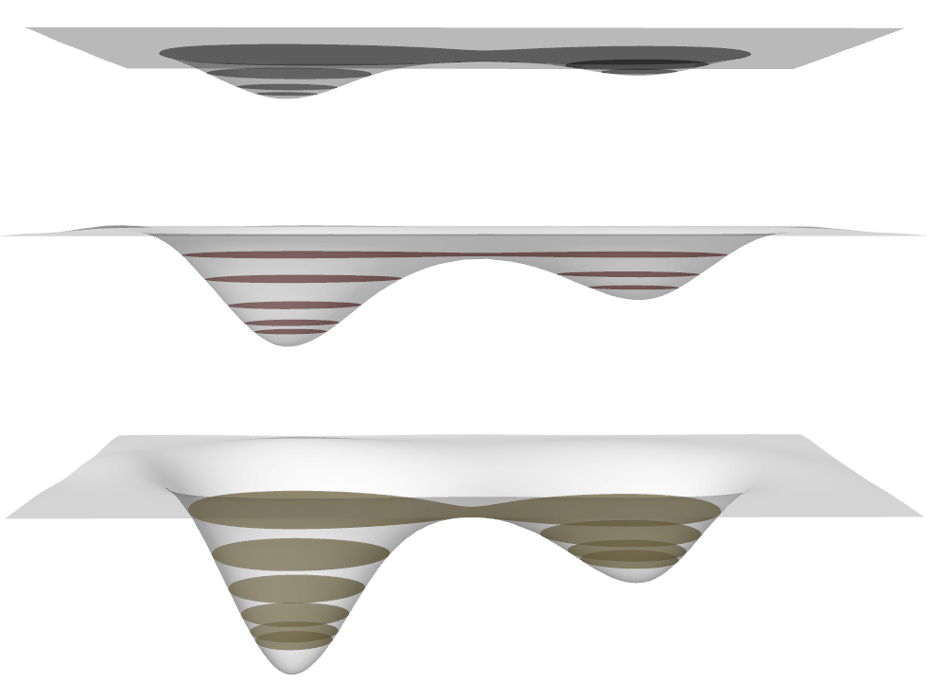
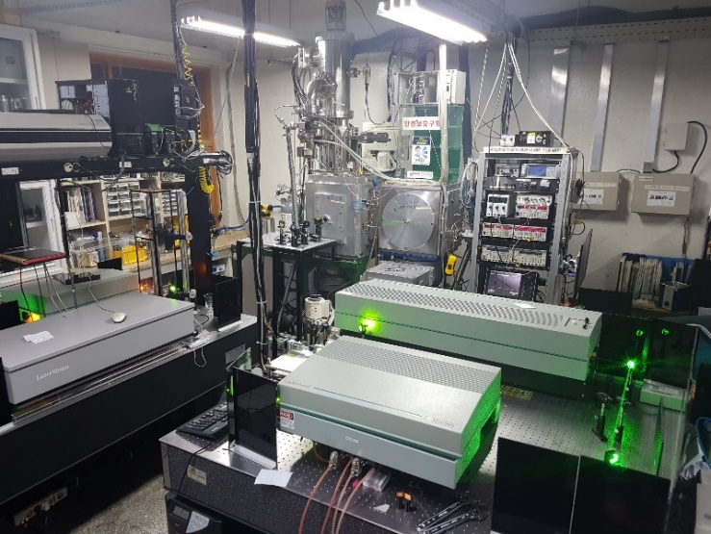
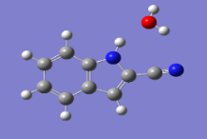
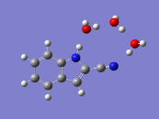
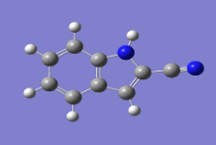
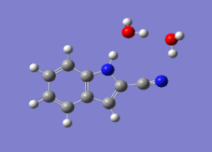

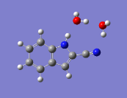
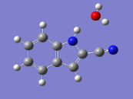

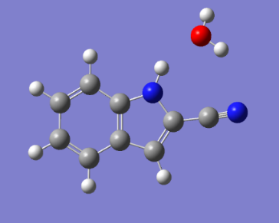
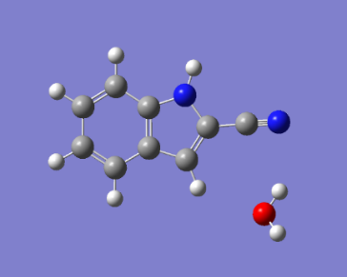

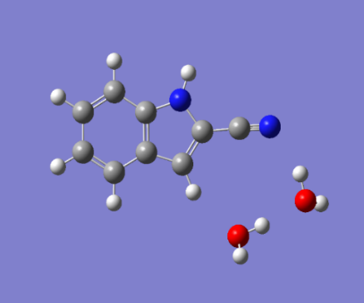

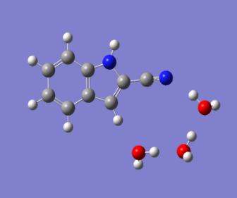
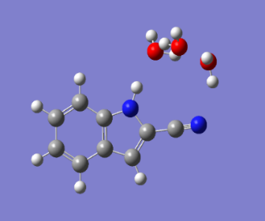
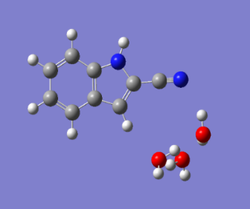



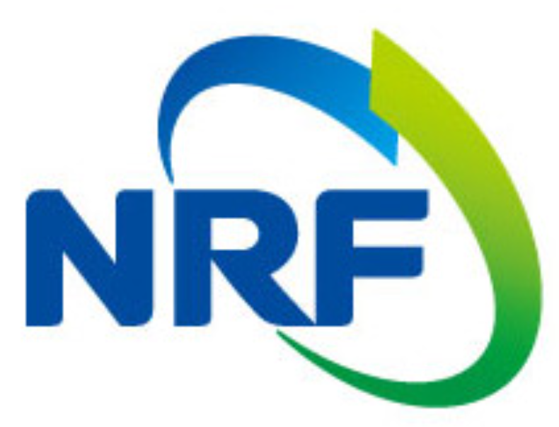
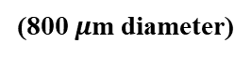
Vibronic spectra of jet-cooled 2-cyanoindole and its water clusters their and computational calculations
Hak Seung Ryu, Cheol Joo Moon, Ahreum Min, Woo Yeong Kim and Myong Yong Choi *
Department of Chemistry (BK21+) & Research Institute of Natural Science,
Gyeongsang National University, Jinju 52828, Republic of Korea
e-mail: mychoi@gnu.ac.kr
Abstract
In this study, the excitation spectra of 2-cyanoindole (2CI) and its water clusters, 2CI-(H₂O)_{n} (n = 1-3), have been measured by using mass-selected resonant two-photon ionization (R2PI) in the gas phase. A broad spectral feature of the R2PI spectrum of 2CI was obtained; while sharp spectral R2PI spectra of 2CI-(H₂O)₁₋₃ clusters were observed. The origin band of each cluster shifted to the red frequency as the number of water increased.
The transition energy of the origin band of the R2PI spectrum was compared with that obtained by density functional theory calculations. To further investigate the
2CI-(H₂O)₀₋₃ systems, we have employed the various gas-phase spectroscopic techniques, such as UV-UV hole burning (UV-UV HB) and IR-dip spectroscopy.
Experimental System
Carrier gas
hυ₁
MCP
Time of flight chamber
MCP
To TOF-Mass
2” Diffusion pump
Source chamber
Oven
Skimmer
Molecular beam
BBO crystal
Dye Laser
(ND 6000)
Nd:YAG Laser
(surelite Ⅱ)
Laser vision
Ionization chamber
Electronics system
(800 $μ$m diameter)
Continuum, ND 6000
10” Diffusion pump
hυ₂
Pulsed Valve System
6” Diffusion pump
Figure 3. Supersonic expansion in the pulsed valve system.
Skimmer
D₀
In pre-expansion
UV energy
Continuum, ND 6000
300K
Multi-Photon
S₁
Continuum, Surelite Ⅱ-10
Figure 1. 3D schematic of the experimental setup. The molecular beam machine consists of three differentially pumped chambers.
Figure 2. Molecular beam machine and laser system.
Cool down
Zreo-point vibrational level
~10K
S₀
Figure 4. Schematic diagrams of potential energy surfaces in the pre-expansion at the room temperature, 300K (upper), and low temperatures after supersonic expansion (bottom).
Figure 5. Schematic view and beam path of the laser system of mass-selected resonant two-photon ionization (R2PI)
Results
TOF Mass
R2PI spectra of 2CI(H₂O)_{n} (n = 0-3)
2CI
2CI (H₂O)₃
2CI (H₂O)
(m/z : 159.70)
32591.9 cm⁻¹
2CI (H₂O)₃
(m/z : 194.64)
2CI (H₂O)₂
2CI
(m/z : 142.19)
2CI (H₂O)₂
(m/z : 177.19)
32700.0 cm⁻¹
2CI (H₂O)
32997.9 cm⁻¹
2CI
Figure 6. Time-of-flight (TOF) mass spectrum of 2-cyanoindole
Figure 7. R2PI spectra of 2-cyanoindole (2CI) and its water clusters, 2CI-(H₂O)_{n} (n = 1-3)
Figure 8. R2PI spectrum of 2-cyanoindole
2CI(H₂O)
2CI(H₂O)₂
2CI(H₂O)₃
2CI(H₂O)-A
2CI(H₂O)-B
2CI(H₂O)₂-A
2CI(H₂O)₂-B
2CI(H₂O)₃-A
2CI(H₂O)₃-B
2CI(H₂O)₃-C
2CI(H₂O)₃-D
Figure 9. R2PI spectrum of 2-cyanoindole-H₂O
Figure 10. R2PI spectrum of 2-cyanoindole-(H₂O)₂
Figure 11. R2PI spectrum of 2-cyanoindole-(H₂O)₃
Table 1. Relative energies (kJ/mol) calculated by DFT theory are listed for the 2CI-H₂O.
Table 2. Relative energies (kJ/mol) calculated by DFT theory are listed for the 2CI-H₂O₂.
Table 3. Relative energies (kJ/mol) calculated by DFT theory are listed for the 2CI-H₂O₃.
Method/Basis-set | Relative Energy (kJ/mol)
B3LYP/6-311++G(d,p) | 2CI(H₂O)-A | 2CI(H₂O)-B
 | 0 | 16.436
Method/Basis-set | Relative Energy (kJ/mol)
B3LYP/6-311++G(d,p) | 2CI(H₂O)₂-A | 2CI(H₂O)₂-B
 | 0 | 25.696
Method/Basis-set | Relative Energy (kJ/mol)
B3LYP/6-311++G(d,p) | 2CI(H₂O)₃-A | 2CI(H₂O)₃-B | 2CI(H₂O)₃-C | 2CI(H₂O)₃-D
 | 0 | 29.04383 | 18.10317 | 38.55095
Acknowledgements
Conclusions
R2PI spectra of 2-cyanoindole (2CI) and its water clusters, 2CI-(H₂O)_{n} (n = 1-3), were measured by utilizing the Thermal evaporation supersonic jet-cooled
technique. For monomer, R2PI spectrum was obtained, but with a broad spectral feature. However, it was possible to observe sharp spectral peaks for 2CI-(H₂O)₁₋₃ clusters upon adding water. Moreover, the origin band of each cluster shifted to the red frequency as the number of water increased. The conformational structures of 2CI and 2CI-(H₂O)_{n} (n = 1-3) have been studied by using R2PI and DFT calculation. To further investigate the 2CI-(H₂O)₀₋₃ systems, we have employed the various gas-phase spectroscopic techniques, such as, UV-UV hole burning (UV-UV HB) and IR-dip spectroscopy.

